Slide 1



The Art of Decomposing Monoliths
To microservice or not to microservice
Kfir Bloch
Head of Backend Engineering @ Wix
@kfirondev
Notes:
Good morning Kiev
I have been working as a developer for the past 17 year
Past 5 years
In this talk I will share with you the aspects of when to break your monolith and how to mitigate the risks
You may contact me on my twitter

Slide 2





Kfir Bloch
Head of backend engineering @ Wix
17 years experience as hands-on developer
Joined Wix 5 years ago
Your pic here
kfirb@wix.com
linkedin/in/blochkfir
@kfirondev
github.com/kfiron

Slide 3

Notes:
Wix is website builder,
You can builder website, your sister brother
It is easy

Slide 4
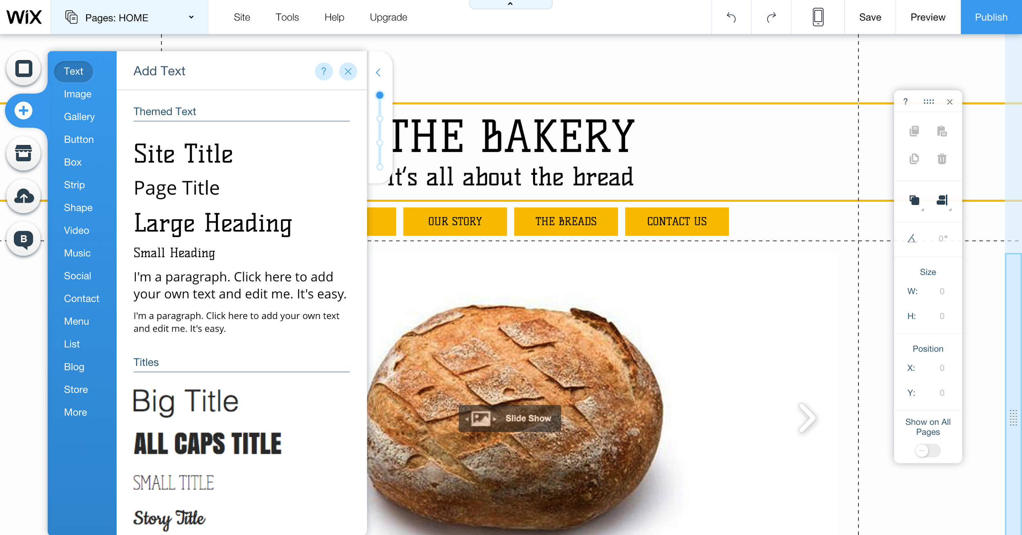
Notes:
And this is wix what you see what you get editor.
A friend described Wix as powerpoint for the web.
We help small buisnisess to get online presensee
We have customise solution for hotels, ecommmerce etc

Slide 5
Wix in Numbers
Over 72M users (website builders)
Static storage is >2PB of Data
3 data centers + 3 clouds (Google, Amazon, Azure)
2B HTTP requests/day
1,000 people work at Wix
@kfirondev
Notes:
Just to let you undesrstand the scale of Wix

Slide 6



Wix R&D
~350 engineers in 3 locations (Tel Aviv, Dnipropetrovsk & Vilnius)
Scala
React
Angular
TDD
Continuous delivery
@kfirondev
Notes:
We have around 350 engineers in 3 locations, the major one in TLV.
We have growing location in Dnipo And Vilnlius
These are the major stacks and methodology the we have being using

Slide 7
Wix and Microservices
In the past 3 years we migrated to a Microservices architecture. It helps us:
Scale our software
Scale our people
Meet product and marketing life cycle
Embrace ownership and maintain a “startup-ish” culture
~150 different services
@kfirondev
Notes:
Back in 2010 we had a monolith, a wild monster
we suffered from many problems which stopped us for being agile
And in the past 4 years we moved towards microservices, which helped us:
Read from the slide
Monolith to microserce

Slide 8
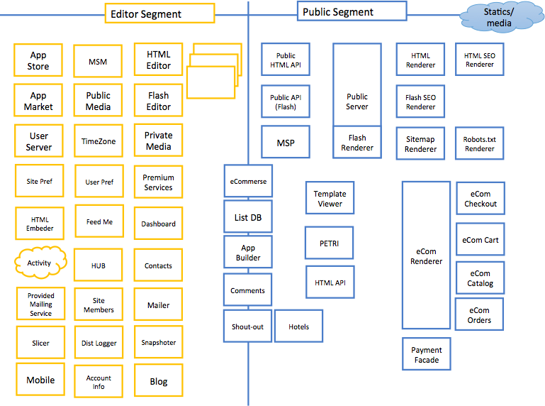
@kfirondev
Notes:
This is bird eye view with will give you a sense of what we are doing
Of course that we don’t have here 150 services, as we speak this list is keep growing

Slide 9
Microservices is the new black
@kfirondev
Notes:
Microservices is the trend, eveyone wants to be there and needs to be there

Slide 10


In computing, microservices is a software architecture style in which complex applications are composed of small, independent processes communicating with each other using language-agnostic APIs.
These services are small, highly decoupled and focus on doing a small task, facilitating a modular approach to system-building.
@kfirondev
Notes:
However, microservices does not nsasarili small

Slide 11

Microservices characteristics
SOA
Protocol
Replaceable
Units
Scalable
Units
Service
Discovery
Circuit
Breaker
Cascading
Failure
Service
Graph
Documentation
@kfirondev
www.maplecityrubber.com
Notes:
Microservices has many aspects, I am not going to speak about them.
It is not part of my talk, but I will be around and would to disucus any of this items, or you can tweet me

Slide 12
But I will talk about:
When (and when NOT) to decompose your monolith
@kfirondev

Slide 13
Why do you think it is important to know when to decompose?
Sometimes less is more
@kfirondev
Notes:
Don’t rush and decompose your monolith to small pieces before you undesratnds that ->

Slide 14

Microservices have trade-offs
@kfirondev
Notes:
Like any other good thing there is pay

Slide 15

Each I/O hop is a failure point
Partial deployment
Ops complexity
End-to-end testing is challenging
Strong interfaces between services are harder to refactor
@kfirondev
Notes:
Failure point: DNS. Uncertainty, you don’t what will happen
Ops
Building the orchestration is hard, when you have one server you just install it once
Partial – Sometimes small feature is developed in few services, so it is hard to handle
Ops complexity – in the back days when we had a monolith all we need to di is to install single server which is the same
Strong interface – Now we live in a worlds when any change of interface is complex. In the monolith env we just refactor. Now we can break our users.. Mmm
Testing is different – now we need to run in our test suite all of the 150 services?

Slide 16
Mitigations
I/O hops are failure points
Proper HTTP configurations (timeouts, async, etc.)
Retry mechanism
Idempotent API
Circuit breakers
Monitoring
Eventual consistency when needed
@kfirondev
Notes:
Configure your http connection, connection pooling,
Retry? How many, whith delay? Exponential?
Itempotanece? – they like global distributed transactions
Folt tollerant?
Proper monitoring tool??
Eventual consisten
Advanced – self healing

Slide 17
Mitigations
Partial deployment
Feature toggle mechanism
@kfirondev
Notes:
Let’s you deploy wiyhout the feature and open it only when all servers are up

Slide 18
Mitigations
Ops complexity
Automation
Developers own the Ops
@kfirondev
Notes:
Culture when the developers care about the ops
Developers are not only coders

Slide 19
Mitigations
Strong interface – hard to refactor
Backward / forward compatibility
Strong build system - dependency
Proper contact tests
@kfirondev
Notes:
Backward and forward compatability
Build system with proper tests that covers when you break the interface

Slide 20
There is no way to avoid the additional risk
Another service == Another failure point
@kfirondev
Notes:
So we have trade offs, we know how to mitigate.
BUT
Read! Remember: even if doing the best things, when we go IO we live in uncertainty environment
Even if you do gazilion retry and you have the best ops guys, you couldf not avoid the risks

Slide 21
Once we accept our limits, we go beyond them.
- Albert Einstein
@kfirondev
Notes:
But we are here because we think that microservices is good
I told you that Wix bla bla bla
Now, let’s take advantage of the limits

Slide 22
To microservice or not to microservice?
@kfirondev
Notes:
Soooo, to be or not to be

Slide 23
01
Decompose to gain resource isolation for high availability
Notes:
The first case is desgradation of service

Slide 24

Client Web
Items (CRUD)
Items Catalog Service
Items DB
File Upload
File Storage
Client cannot perform critical missions like deleting an item
Server threads are busy on I/O
Network problem
Server cannot accept any more requests
@kfirondev
Notes:
In this use case we have an online shop items catalog with 2 APIs
Items – add/del
Load files – images for my producs
So we have network issue to the external file storage…
Non critical affect the critical
The site owner cannot change the inventory which is critical because he does not have the
Items
The upload of the items is not critical,

Slide 25
Different APIs have different SLAs
Some are near real time & some are not
Some are eventually consistent
Some are not critical and can fail
Some should respond within X ms
@kfirondev
Notes:
SLA is product definition, we as a developer does not define SLA
We use SLA definition to know when to decouple our services
Each API has different importance: payment transaction is different from bi logging and different from search capability
Some need to be addressed Immediately, some eventual consistent,
Eventual consistent may be a case when we have authorative db and we want to have index server
Some APIs cannot be depend on any other server
Some can be depend on 20 hops
Some APIs are no critical, foe example suggestion system

Slide 26
Decompose to avoid competition on shared resources
@kfirondev
Notes:
This is the most canonical use case to decompose our micro services
Talk to your product manager, SLA is prduct definition

Slide 27
Client Web
Items (CRUD)
Items Catalog Service
Items DB
File Upload
File Storage
@kfirondev
Notes:
So the solution will be to have another service
If the files service need to be enriched with meta data from the catalog it can depend on it.

Slide 28
Client Web
Items (CRUD)
Items Service
Items DB
File Upload
Files Service
File Storage
@kfirondev
Notes:
So the solution will be to have another service
If the files service need to be enriched with meta data from the catalog it can depend on it.
If the files service needs data, it can depend on it.

Slide 29
02
Decompose by different life cycles

Slide 30
Items (CRUD)
Items Catalog Service
Items DB
BI Storage
Coupons
4 PM Deploy – Items catalog feature
5 PM Deploy – Coupon feature
6 PM Deploy – Coupon feature
9 PM Deploy – Coupon feature
THE COMPANY LOSES MONEY
12 AM Rollback – Due to bug in items catalog
@kfirondev
Notes:
So, our catalog server has some coupons functionliy
The team is spending 50% of the time doing critical logic which helps the company to increase the income
Also we have risk for catalog because of deplpyment of coupon
In wix we deploy 20K deployments per year, we have different lifeccyle for diffent projects
Some product are not changed, some are heavy intetnsive changes, and they risk each other

Slide 31
Items (CRUD)
Items Catalog Service
Items DB
B1 Storage
Coupons
@kfirondev
Notes:
Now we can deploy them idenpendently
In Wix we have 20K deployments in year

Slide 32
Items (CRUD)
Items Catalog Service
Items DB
B1 Storage
Coupons Service
@kfirondev
Notes:
Now we can deploy them idenpendently
In Wix we have 20K deployments in year

Slide 33
03
Decompose to reuse and share logic
Notes:
Share logic is what we are mostly doing as software developer, this is what we paid for
That is what we are doing as developers, we share logic of class, method, component
We are sharing logic, to do not repeat ourselves.
Let’s doe not repeat ourseleves here

Slide 34
Items Catalog
Service
User Management Service
Items DB
User Management Service
User DB
Items DB
User DB
Geo
Geo
Geo
Geo
Geo DB
Geo (3rd party)
Google
@kfirondev
Notes:
So our items catalog service also have GEO capability.
A piece of logic which resolve the user country/city by the IP. Also maps is possible.
This piece of logic have some cache in the database
Now the user management service also need to resolve the geo..
So let’s decompose

Slide 35
Items Catalog
Service
Items DB
User Management Service
User DB
Geo
Fetch Geo
Fetch Geo
Geo Service
Geo DB
Geo (3rd party)
Google
@kfirondev
Notes:
Great, now we have runtime depdedency from both services

Slide 36
Common mistake to avoid
Items Catalog
Service
Items DB
User Management Service
User DB
Geo
Geo
Geo
Geo DB
Geo (3rd party)
Google
WILL FAIL AT SOME POINT
@kfirondev
Notes:
Common mistake to avoid
When many services uses the same DB it is hard to manage
Better to have runtime dependency
Now lets say that we need this GEO functinality in 20 services
So 20 of them will connect to the database for read and write?
How do we monitor this functiuonality? Look at 20 servers?

Slide 37
Each service must have its own DB
@kfirondev
Notes:
This is the most impotant principle we adopt when we broke Wix into microservices
Each service, has its own DB.
We have only one single case that one service is writing and other service is reading. But this was design for high thoughput
And we use the same code base, we need avoid such cases

Slide 38
An example when not to decompose
Service A
DB
Service B
DB
Extract Cookie Info
Extract Cookie Info
@kfirondev
Notes:
Now let’s have another case when two services need to deserialize and decrypt the user cookie
No, we should not decompose it to another micro service. because

Slide 39
Microservices are deployable artifacts that have Ops or I/O dependencies
@kfirondev
Notes:
The IO hop that you pay just for read the cookie is much more expensive than the logic
Cookie ser is a shared because it doe not have implicit dependency for Ops/IO
Exceptional case to decompose is when you have high intensive CPU 3d and so

Slide 40
Tested code that is CPU-bound is more secure and consistent
@kfirondev
Notes:
Again this is certainty.

Slide 41
04
Decompose to have single team responsibility

Slide 42
Did you know that 90% of R&D projects fail?
Because of content
Because of bugs
Because of time to market
Do you know how to reduce it to 70%?
3-5 developers on 1 team
3-5 months per project
@kfirondev

Slide 43
Decompose to support organization scalability
@kfirondev
Notes:
Yes, service decompozition helps your org to scale by people

Slide 44
Large teams cannot efficiently handle a large code base
Small teams embrace responsibility and accountability
@kfirondev
Notes:
Large code base is hard to maintain by many people.
Small code base + small team is easy, even from the task and the way they divided by the team
It also makes your people feels owner, the are part from small group.
They have target and customers which are the other services. It is like company

Slide 45
Any organization that designs a system (defined broadly) will produce a design whose structure is a copy of the organization's communication structure.
Conway’s law
@kfirondev
Notes:
But we are here because we think that microservices is good
I told you that Wix bla bla bla
Now, let’s take advantage of the limits

Slide 46
Decomposition helps your culture remain startup-ish when your size is corporate-ish
@kfirondev
Notes:
In the end we want to have startupish environment.
We want that culture. We don’t want to be corporate even if we are.

Slide 47
Decomposition allows each small team to have ownership of a service
@kfirondev
Notes:
Decompose endlessly until you have small teams
Wix guilds and gangs

Slide 48
Wix Org chart - “Guilds & Gangs”
Micsroservices is the only way to support this HR methodology
@kfirondev

Slide 49
When to break the monolith
01 Resource Isolation by service level
02 Different release cycles
03 Reuse and share logic
04 Develop & maintain by a single team
Decompose to avoid competition of shared
resources
Decompose to meet your product’s life cycle strategy
Decompose to share logic with dependencies
Decompose to meet your HR needs
@kfirondev
Notes:
Lets recap the motivation to break our monolith:
Source isolation, know your SLA / importance of the API
Lifecycle, know the needs of you fequency of deployments
Reuse logic which hace Ops dependency
Break to small teams

Slide 50
Microservices start from a monolith and should be created with caution
@kfirondev
Notes:
In reality we don’t do full microservices

Slide 51
From monolith to microservices:
Practices to start with
Notes:
I would like to give you some tips to manage your risks

Slide 52
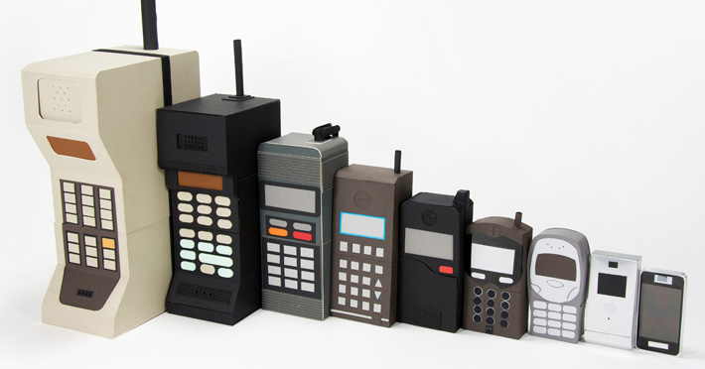
Make changes gradually
@kfirondev
www.livbit.com
Notes:
Always have fallback.
When you introduce new service and you alredy have your ligic in your monolith, transfer the traffic gradually
Be able to turn it of at any time
In Wix we had mailing service, we broke it, we had ft bla bla bla
Talk about GEO example

Slide 53

Don’t start with your most critical service
@kfirondev
Notes:
If you don’t want to lose your job, don’t’ start with the most important project
Suggestion system for similar products
This will give you the confidence on your mi

Slide 54
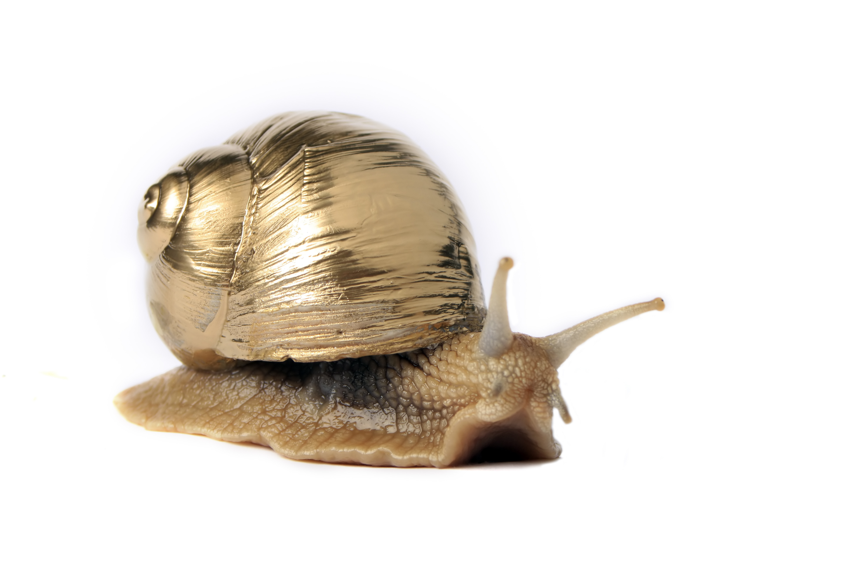
Confidence is built slowly
Notes:
Talk about the new service, use the term, let people use it, let your managers use it.
Take the time, show the success, communicate
In Wix when we started we had many failure and we had many rollbacks, but in the end people got the confidence

Slide 55

Use proper monitoring from day one
www.capacitysolutionsplatform.com
@kfirondev
Notes:
We monitor both business transactions and hardware low level
Newreiic
Anodot
Graphite
Take metrics and investigate them
Do bug hunts – It will educae your people

Slide 56

Talk about failures and their causes
Notes:
Post mortem,
Be educative

Slide 57
The secret of getting ahead is getting started.
- Mark Twain
@kfirondev
Notes:
You need to start from something

Slide 58
Kfir Bloch
kfirb@wix.com
linkedin/in/blochkfir
@kfirondev
github.com/kfiron

Slide 59
Wix Engineering Blog http://engineering.wix.com/
We are hiring http://jobs.wix.com
email jobs@wix.com
Kfir Bloch
@kfirondev

